Slide 1
Lab-1
Assignment

Slide 2
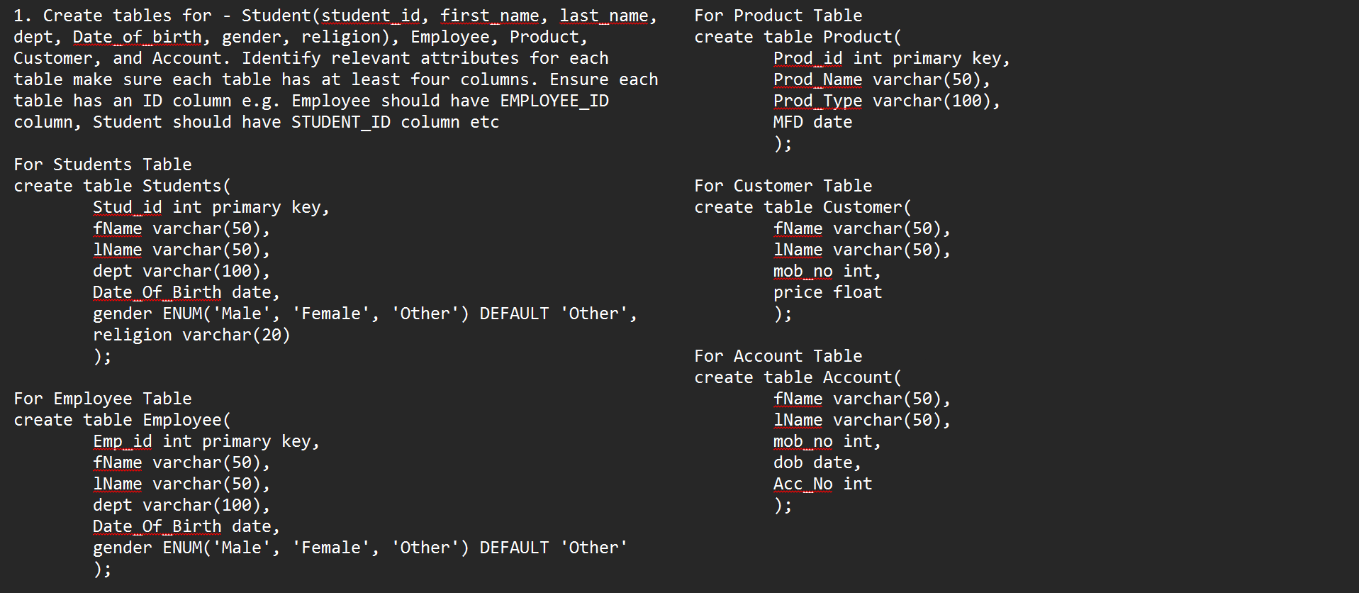
1. Create tables for - Student(student_id, first_name, last_name, dept, Date_of_birth, gender, religion), Employee, Product, Customer, and Account. Identify relevant attributes for each table make sure each table has at least four columns. Ensure each table has an ID column e.g. Employee should have EMPLOYEE_ID column, Student should have STUDENT_ID column etc.

Slide 3
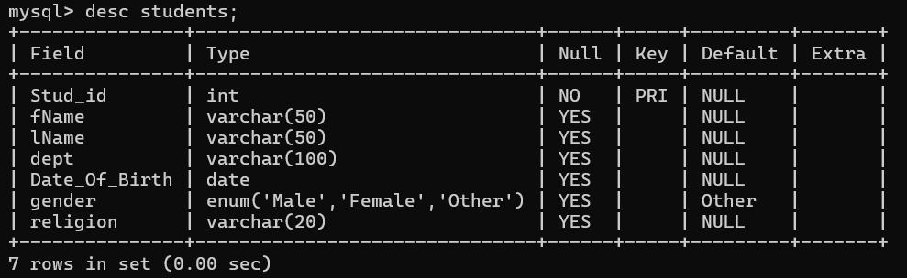
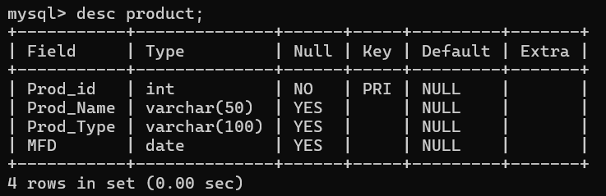
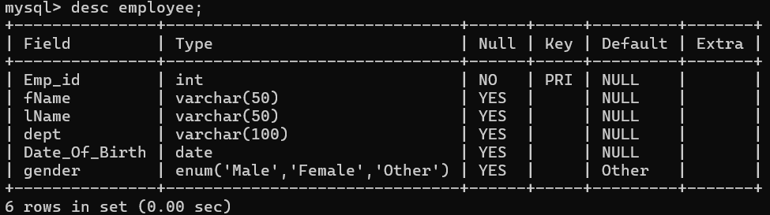
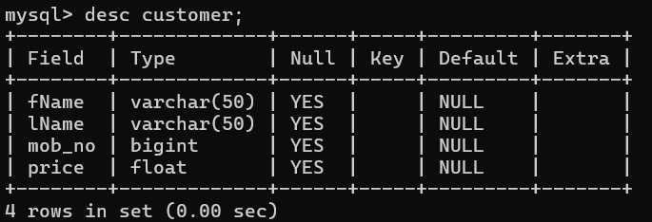
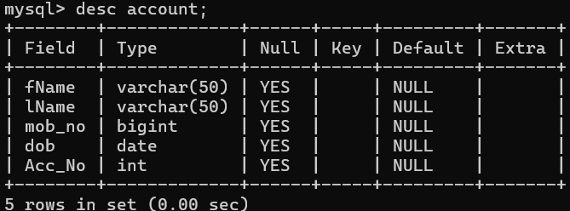
2. Describe each table.

Slide 4
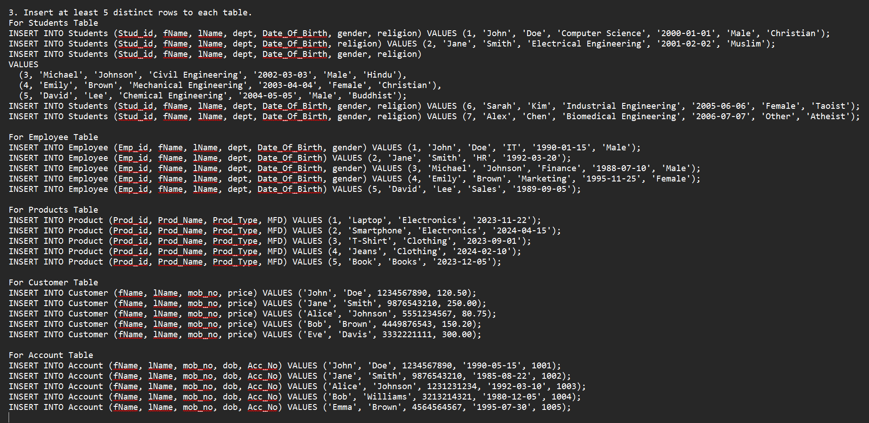
3. Insert at least 5 distinct rows to each table.

Slide 5
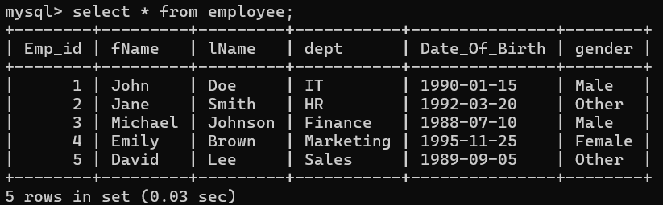
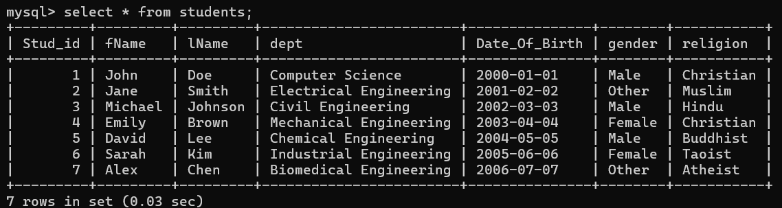
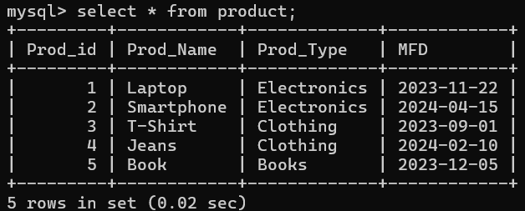
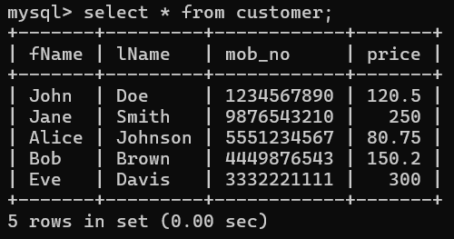
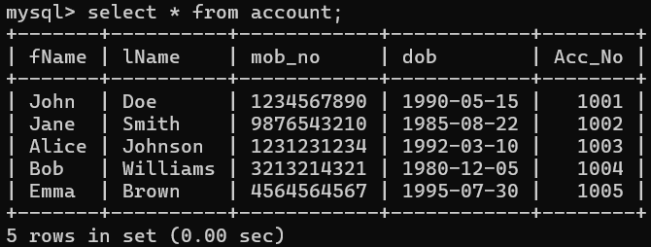
4. Fetch all data from the respective tables.

Slide 6
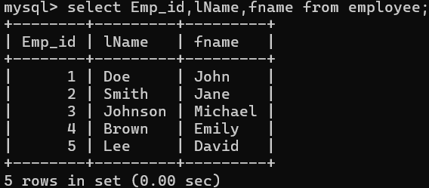
5.Fetch Employee ids and their names from Employee table

Slide 7
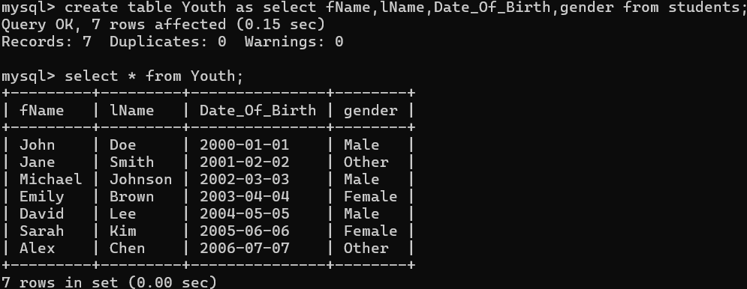
6.Create table YOUTH (f_name, l_name, sex, DOB) from the Student table.

Slide 8
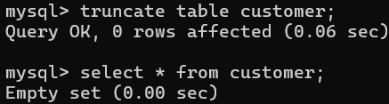
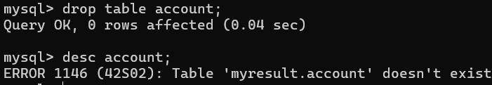
7. Delete all data from the customer table.
8. Delete the Account table.

Slide 9
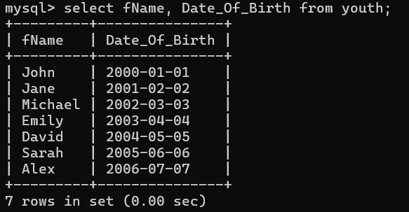
9. Fetch the f_name and DOB from YOUTH table.

Slide 10
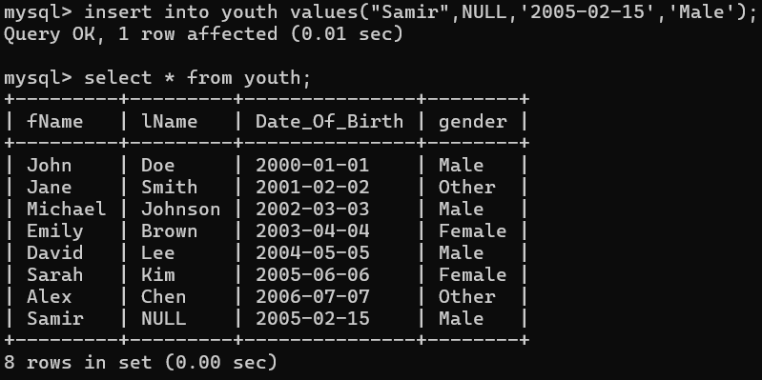
10. Insert a new record into the Youth table. And keep NULL value in the l_name column.

Slide 11
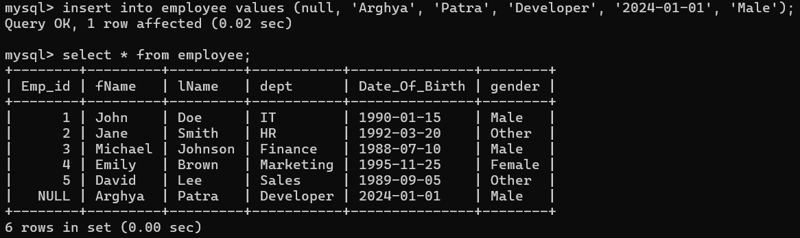
11. Insert a new record into the Employee table. And keep NULL value in the employee_id column.

Slide 12
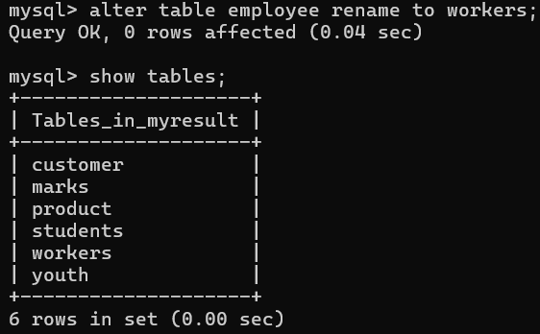
12. Change the name of the employee table to workers.

Slide 13
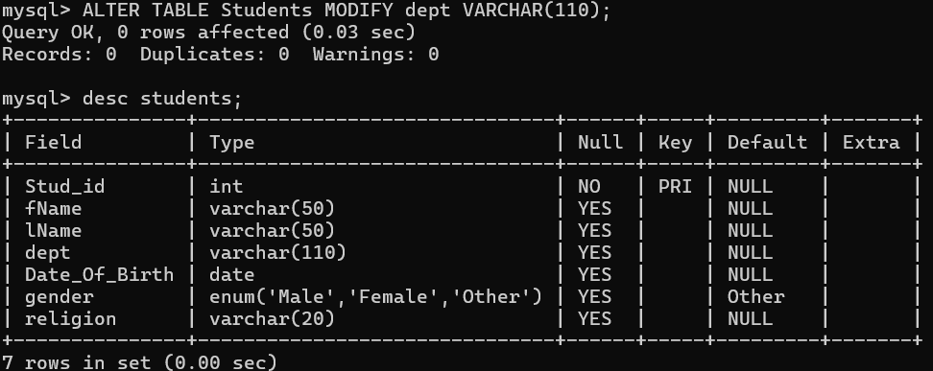
13. Increase the size of the dept field in the student table by 10.

Slide 14
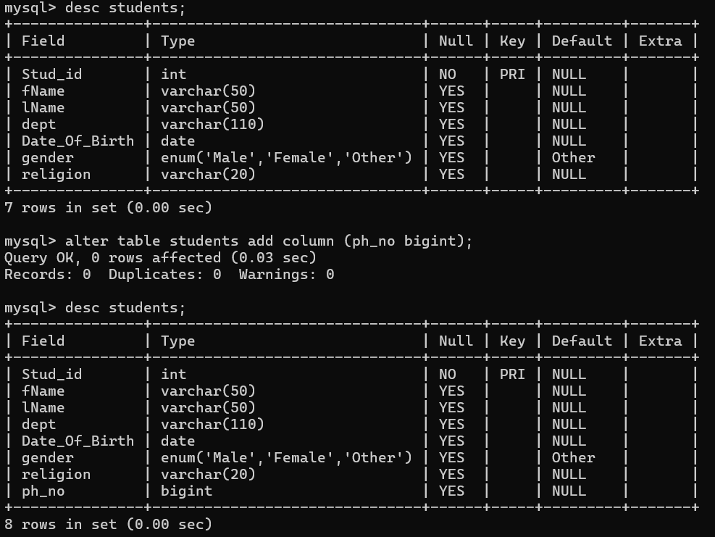
14. Add a column ph_no in the student table.

Slide 15
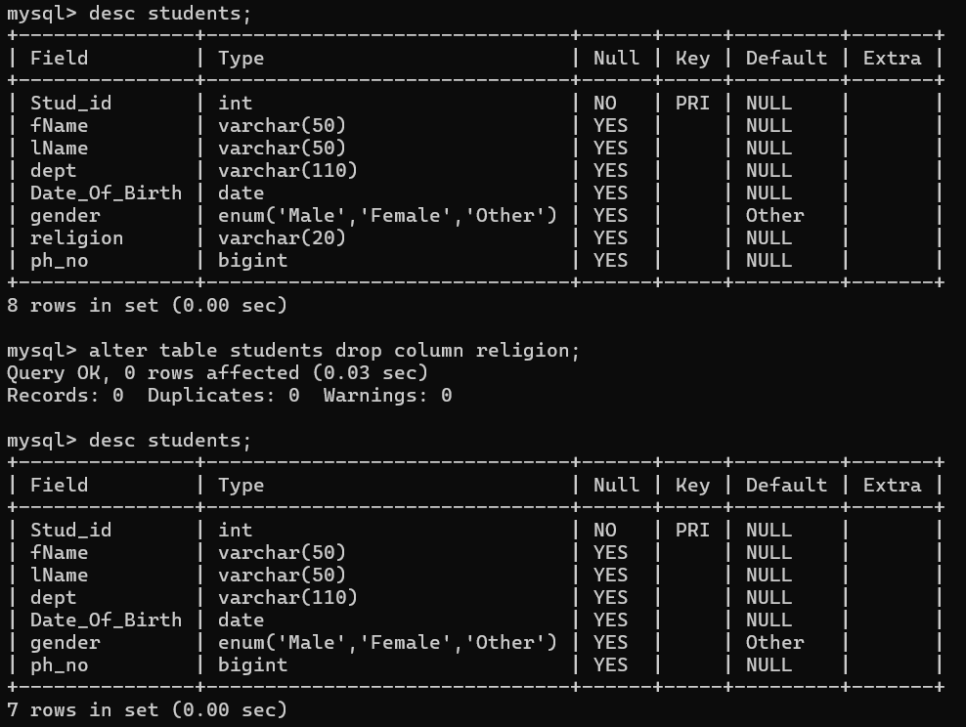
15. Drop the religion attribute from the student table.

Slide 16
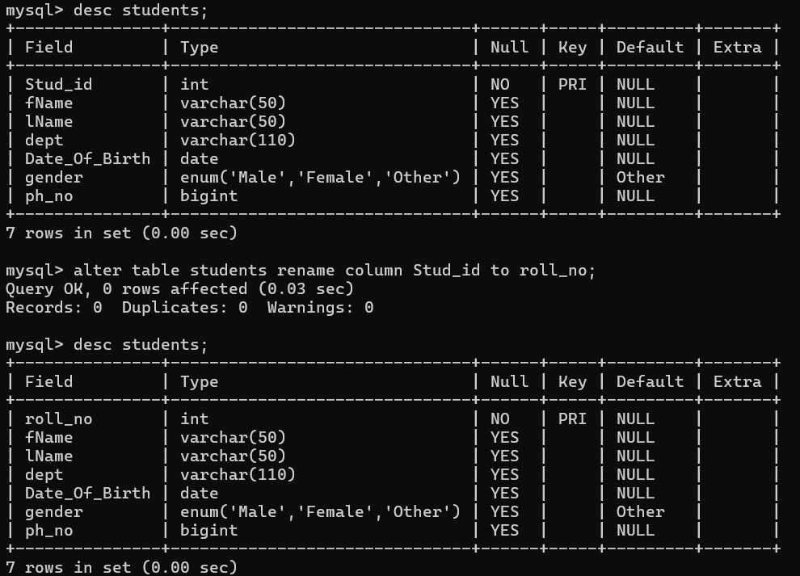
16. Rename the student_id field to roll_no in the student table.

Slide 17
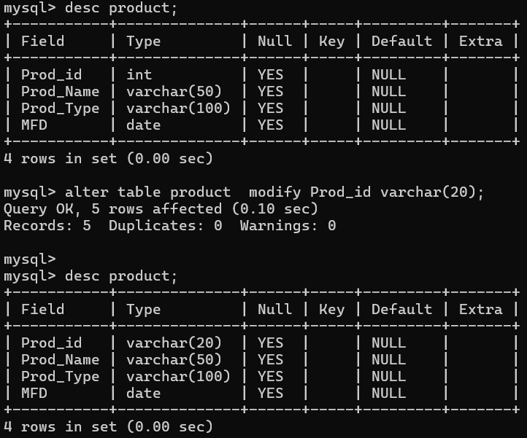
17. Change the datatype and size of the product id column in the product table.

Slide 18
Thank You

